Slide 1
GCP Deployment: Vertex AI
Triloki Gupta

Slide 2
Contents
Vertex AI
Workbench/ JupyterLab
AutoML
Docker
Trained Model Deployment
Flask API Deployment
Conclusion

Slide 3
Vertex AI
Vertex AI is a managed machine learning platform that helps you build, deploy, and scale machine learning models faster and easier.
Why Vertex AI?
Ease of use: Vertex AI provides a unified experience for managing all aspects of your machine learning lifecycle, from data preparation to model deployment. This makes it easy to get started with machine learning, even if you don't have a lot of experience.
Pre-trained models: Vertex AI offers a variety of pre-trained models that can be used to quickly build and deploy machine learning models for a variety of use cases. This can save you time and effort in the development process.
Scalability: Vertex AI is a scalable platform that can easily be scaled up or down to meet your needs. This means that you can start small and then scale up as your needs grow.
Security: Vertex AI is a secure platform that meets the highest security standards. This means that you can be confident that your data is safe.

Slide 4
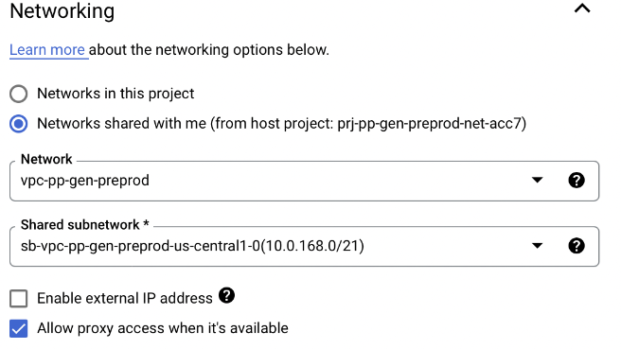
Workbench/ JupyterLab
Managed notebooks provide JupyterLab services and flexible computing resources integrated with Google Cloud services more details
User-Managed Notebooks have JupyterLab 3 pre-installed and are configured with GPU-enabled machine learning frameworks more details
Necessary steps for creating Notebook in Vertex AI more details
Choose the us-central1 option in Region drop down
In the Networking section
Choose the Network shared with me
Unchecked Enable external IP address
Checked to Allow proxy access when it's available

Slide 5
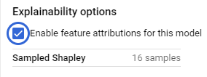
Auto ML
Upload the dataset in the Datasets section
AutoML steps:
Select CREATE from Model Registry
Training method choose Dataset and Objective and Model Training Method as AutoML
Pass Name and Target column under Model details
Training options you can add/remove features
Compute and Pricing pass the number of nodes
Deploy to Endpoint
Pass Endpoint name under Define your endpoint
Add Machine type under Model settings
Leave Model monitoring as it is and click on DEPLOY
Endpoint will be ready in few min
During the endpoint need to check the Explainability options

Slide 6
Docker
Docker is a software platform that allows you to build, test, and deploy applications quickly
Docker packages software into standardized units called containers that have everything the software needs to run including libraries, system tools, code, and runtime
Basics Docker CMD
gcloud auth login
gcloud auth configure-docker us-central1-docker.pkg.dev
docker build ./ -t my-image
docker run my-image
docker tag my-image us-central1-docker.pkg.dev/ford-deeb08c04ecbbaaac14dbfa0/ford-container-images/test-image:version
docker push us-central1-docker.pkg.dev/ford-deeb08c04ecbbaaac14dbfa0/ford-container-images/test--image:version
For more details Link

Slide 7
Trained Model Deployment
Deployed with Pre-built container
Select IMPORT from Model Registry
Pass Name and region
Model settings Select a Pre-built container and choose a Model framework according to the project and pass the model package location in the Model artifact location
Deployed with Custom container
Select CREATE from Model Registry
Under the Training method choose Dataset as No managed dataset
Pass Name in Model details
Training Container select Custom container and choose a container image from the Artifact registry
Under Compute and Pricing choose Machine Type according to the project

Slide 8
Flask API Deployment
Build and Push the docker image in Artifact Registry
Model Deployment
From Model Registry click IMPORT
Pass name and region under the Name and Region section
Under Model settings choose Import an existing customer container also add Prediction route(/predict) and Health route(/health)
Click on IMPORT, the model will be ready in a few min
Deploy to Endpoint
Pass Endpoint name under Define your endpoint
Add Machine type under Model settings
Leave Model monitoring as it is and click on DEPLOY
Endpoint will be ready in few min

Slide 9
Custom Deployment: Key Points
Points need to consider before custom deployment
HTTP server requires 0.0.0.0 host only
Require /health API and HTTP server should respond with status code 200 OK and it should be GET method
The HTTP server accepts prediction requests in JSON format
Prediction request must be 1.5 MB or smaller and it has to be written in JSON
Prediction API should be one API(/predict) with POST method
Every request must contain an instances field
The response from the HTTP server is a JSON dictionary with one field predictions
Each prediction response must also be 1.5 MB or smaller

Slide 10
Conclusion
The biggest adv of a custom container is that we can add extra workflow outside of the ML model
Compared to the optimized pre-built containers, custom containers are more difficult to implement and more complex to set up, but it does provide more flexibility
Everything except for the core logic of model inference is taken care of by Vertex AI either service management or auto-scaling
Considering all these points we can say its basically good for ML model where we can deploy and predict with one API
We can’t pass multiple APIs because it seems dedicated to only ML prediction
Datapoint should be 1k minimum for AutoML

Slide 11
Thank You

Slide 12
Optimization: Vertex AI
There is an upper limit on the timeout of about the 60s(A major drawback of Vertex AI) StackOverflow
With a Standard Machine(2 CPU and 7.5 GB RAM) and CPU TensorFlow env it runs for 20 iterations
With a High-memory Machine(16 CPU and 108 GB RAM) and GPU TensorFlow env, we reached 50 iterations because of timeout
With a High-GPU Machine(96 CPU and 680 GB RAM) and GPU TensorFlow env, we reached 70-80 iterations because of timeout
Sometimes it was failing with a High-memory Machine for 20 iterations

